Slide 1


Paid Social Advertising Analysis
Name: Moumita Islam
Course: Social Media Marketing
Date: 02.17.25

Slide 2
Table of content
Introduction
The Ad Title
Awareness Ad Analysis
Consideration Ad Analysis
Conversion Ad Analysis
Conclusion

Slide 3
Introduction
Paid Social Advertising Analysis
Paid social advertising allows brands to target users based on demographics, interests, and behaviours, creating a more personalized experience. This analysis evaluates three paid social ads—each representing a different marketing goal: Awareness, Consideration, and Conversion.

Slide 4
The Ad Title
“NIKE’S FIND YOUR GREATNESS CAMPAIGN.” –AWARENESS STAGE ANALYSIS
01
“Write A Winning Essay – Better Grades With Grammarly” – CONSIDERATION STAGE ANALYSIS
02
“AMAZON KINDLE PAPERWHITE YouTube Pre-Roll Ad ” – CONVERSION STAGE ANALYSIS.
03

Slide 5
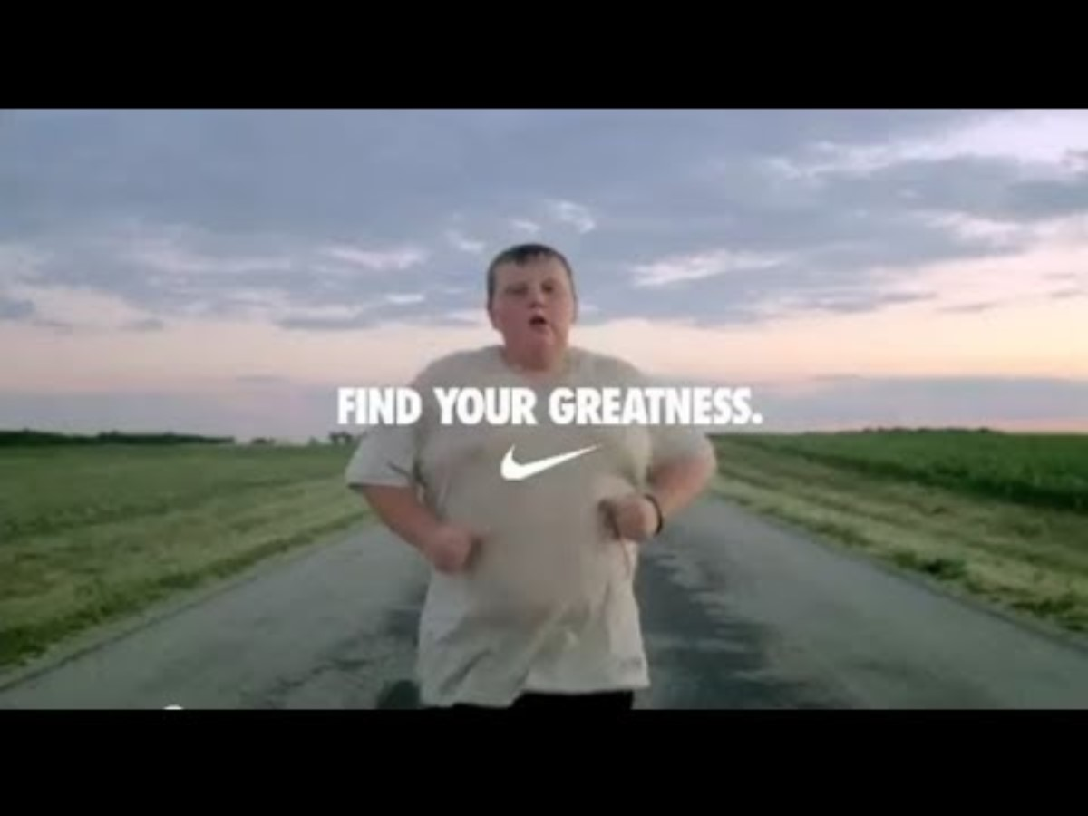
Awareness Ad Analysis
Company: Nike
Product/Service: "Find Your Greatness" Campaign
Main Message: "Greatness is not just for the elite—it exists in everyone, everywhere."
Call-to-Action (CTA): No direct product CTA, but an inspirational brand message.
Platform & Format: Multi-platform campaign (TV, YouTube, Social Media, Digital Ads)
Targeting & Effectiveness
The campaign aimed to connect with everyday athletes rather than professionals, based on a broad demographic appeal, focusing on individuals interested in personal achievement, fitness, and motivation.
Was the targeting accurate? Yes, as it resonated with a broad audience, including those who aspire to push their own limits, aligning with Nike’s brand ethos.
Did the ad work?
✅ Emotionally compelling storytelling that fosters inspiration and motivation.
✅ High reach potential through multi-channel distribution and global relevance.
✅ Strong brand association with personal achievement and perseverance.
Takeaways
This campaign effectively increased brand awareness by positioning Nike as a brand that empowers everyone, not just elite athletes, to find their own greatness.

Slide 6

Consideration Ad Analysis
Company: Grammarly
Product/Service: AI Writing Assistant
Main Message: "Write A Winning Essay – Better Grades With Grammarly."
Call-to-Action (CTA): "Try for Free"
Platform & Format: YouTube Video Ad
Targeting & Effectiveness
based on student and professional writing needs, academic engagement, and interest in productivity tools.
Was the targeting accurate? Yes, as the ad appeals explicitly to individuals looking to improve their writing quality, structure, and grammar for academic success.
Consideration-Stage Impact
1️⃣ Showcased Product Effectively – Demonstrates Grammarly’s real-time corrections, AI-powered suggestions, and plagiarism detection.
2️⃣ Increased Brand Resonance – Uses storytelling, testimonials, and success stories to build trust.
3️⃣ Addressed User Pain Points – Highlights common essay-writing struggles and shows how Grammarly resolves them.
4️⃣ Clear CTA for Action – Strong “Download for Free" prompt, reducing onboarding friction.
Did the Ad Work?
✔ Engaging Demo: Demonstrated multiple features interactively.
✔ Persuasive CTA: Encouraged free trial sign-ups with minimal effort.
✔ Aligned with Audience Needs: Directly targeted students and professionals aiming for better writing.
Key Takeaways
1. Highly effective for the consideration stage, as it differentiates Grammarly from competitors and encourages trial adoption.
2. Optimized for Engagement & Conversion, using relatable challenges and compelling storytelling.
3. Potential Improvement: Adding before-and-after essay comparisons or professor endorsements could enhance credibility.
.

Slide 7

Consideration Ad Analysis
Amazon Kindle Paperwhite – Conversion Stage Analysis
Targeting & Effectiveness
✅ Accurate targeting – e-books and e-readers with strong purchase intent.
✅ Strong CTA ( The Price) – Encourages immediate action, minimizing friction in the buying process.
✅ Emotional and practical appeal—Highlights cozy reading moments and key features (glare-free display, adjustable lighting) to reinforce the Kindle as the best choice.
✅ Effective retargeting – Keeps Kindle top-of-mind by re-engaging a warm audience at the decision stage.
Takeways:
This YouTube Pre-Roll Ad effectively drives conversions by leveraging retargeting, strong visuals, and a direct CTA, making it easy for potential buyers to complete their purchase

Slide 8
Conclusion
This analysis highlights how paid social advertising effectively conveys messages based on user behaviour and intent. Awareness ads focus on broad reach and brand recall, Consideration ads drive engagement and lead generation, and Conversion ads target high-intent users ready to purchase. By aligning ad formats, CTAs, and messaging with audience behaviour, brands can optimize their paid social strategies for maximum impact.

Slide 9
Thank you

